Slide 1

WOMEN CRIME DATA ANALYSIS
By - Dishi

Slide 2
INTRODUCTION
In today’s world, every establishment is facing ever growing challenges which need to be coped up quickly and efficiently. With continually increasing population, crimes and crime rate analyzing related data is a huge issue for governments to make strategic decisions so as to maintain law and order.

Slide 3

The best place to look up to find room for improvement is the voluminous raw data that is generated on a regular basis from various sources by applying Big Data Analytics (BDA) BDA refers to the tools and practices that can be used for transforming the raw data into meaningful and crucial information which helps in forming a decision support system for the judiciary and legislature to take steps towards keeping crimes in check.

Slide 4
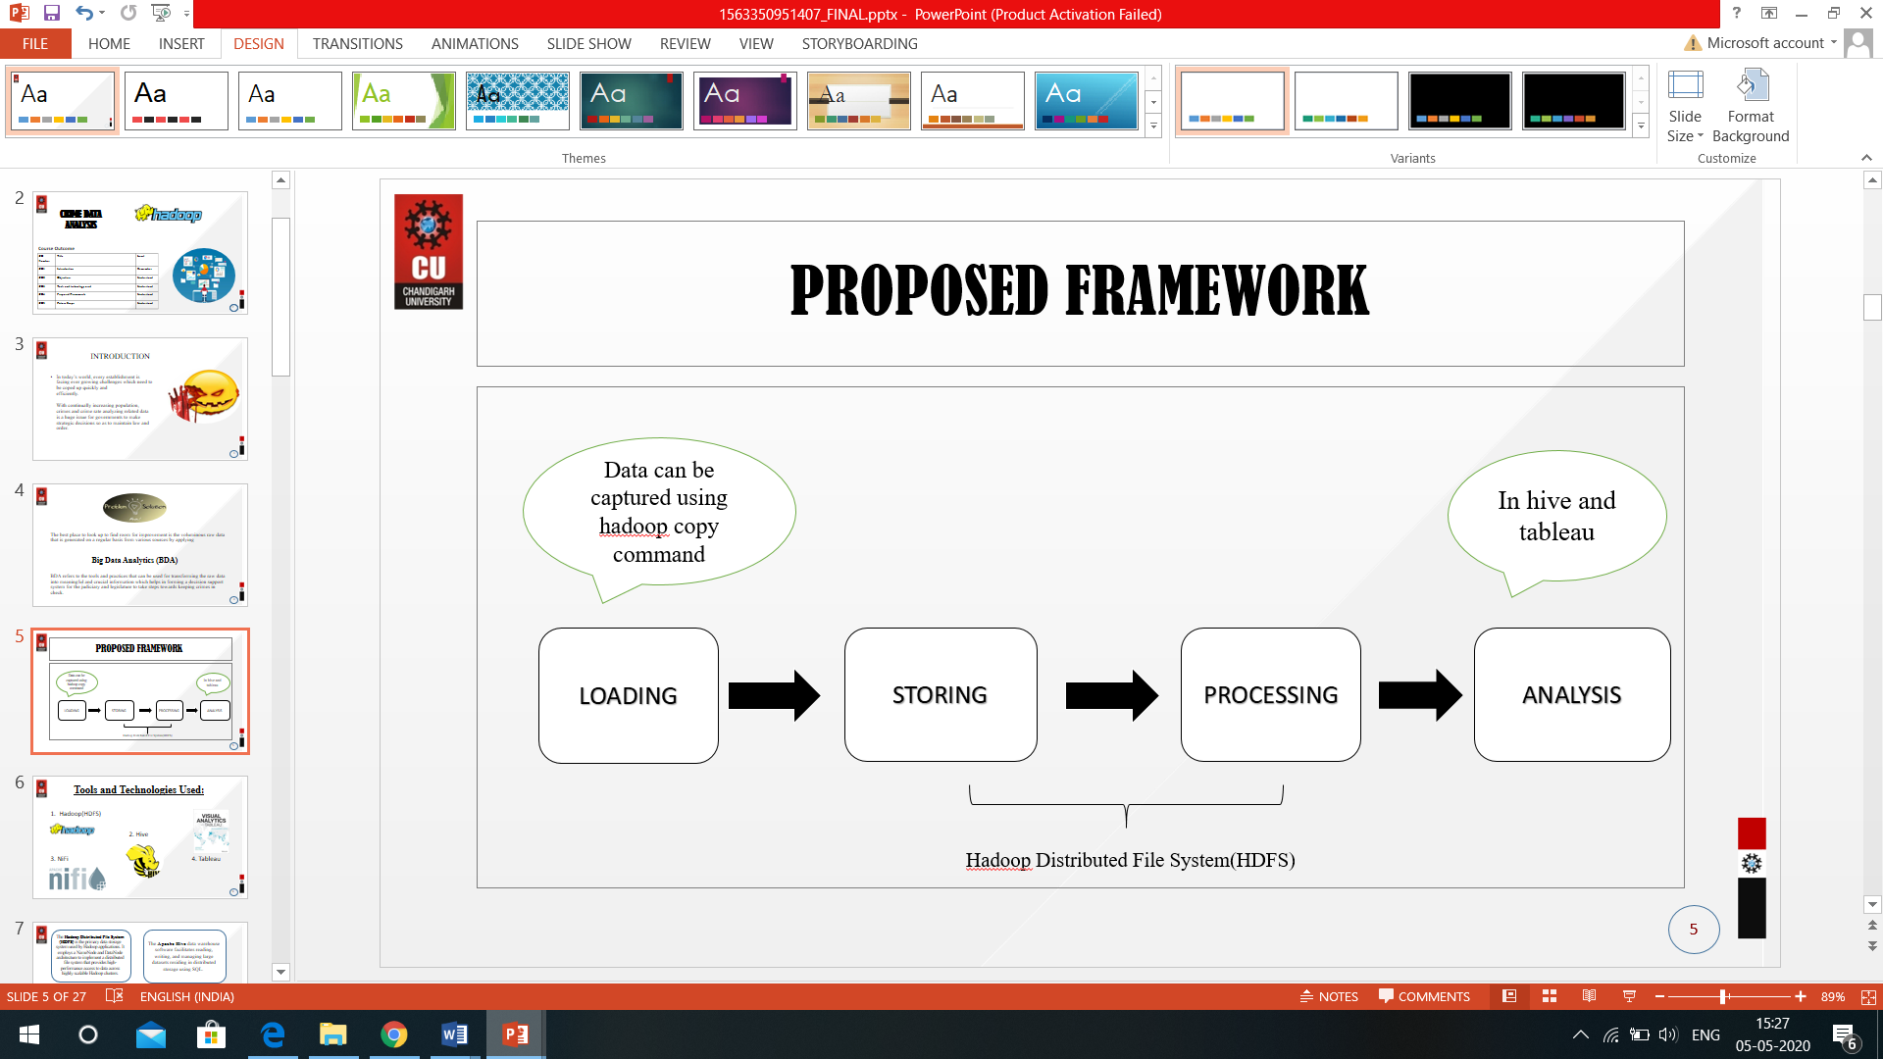
PROPOSED FRAMEWORK

Slide 5
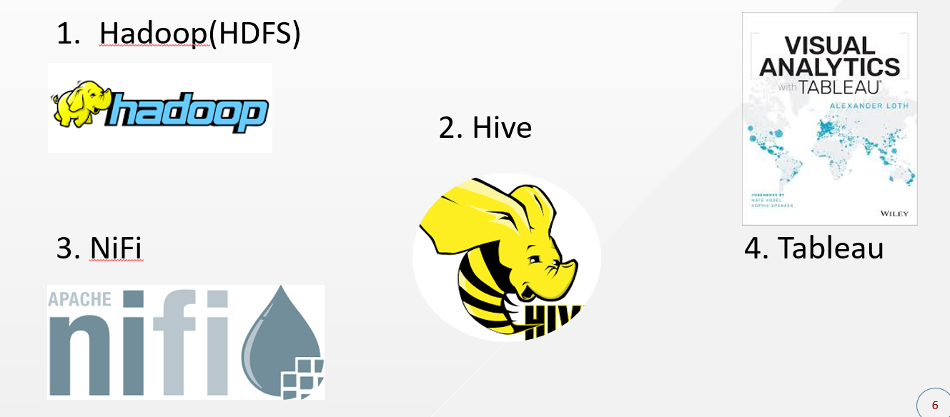
Tools and Technologies Used:

Slide 6
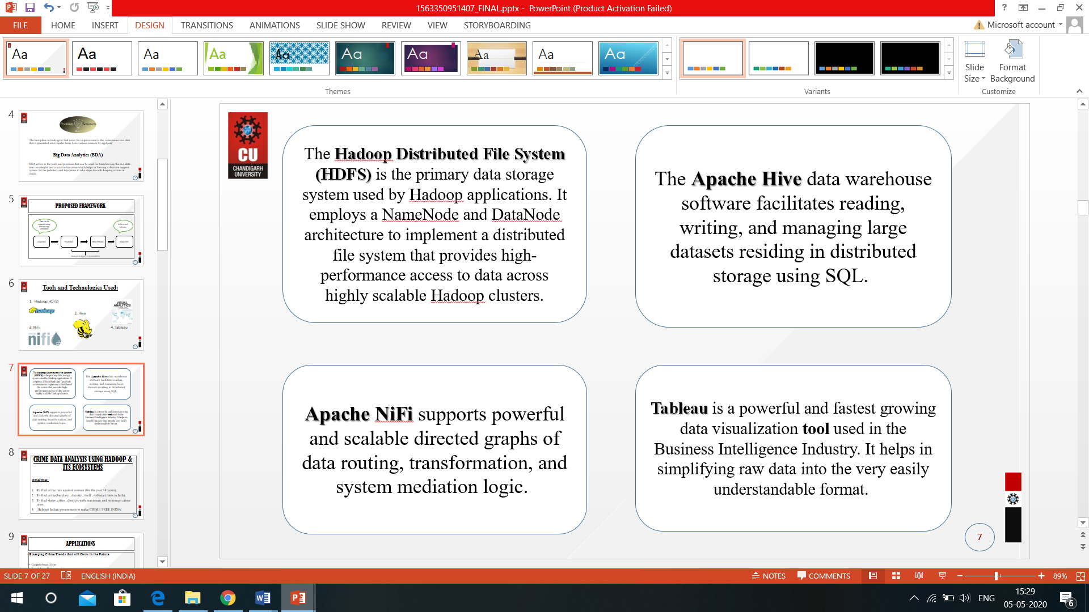

Slide 7
CRIME DATA ANALYSIS USING HADOOP & ITS ECOSYSTEMS
Objectives:
To find crime rate against women (for the past 14 years).
To find crime(burglary , dacoity , theft , robbery) rates in India.
To find states ,cities , districts with maximum and minimum crime rates.
Helping Indian government to make CRIME FREE INDIA.

Slide 8
APPLICATIONS
Emerging Crime Trends that will Grow in the Future
Computer-based Crimes
Knowledge and Information Crimes
Identity Theft
Increased Organization of Crime
Growing Transnational Nature of Crime

Slide 9
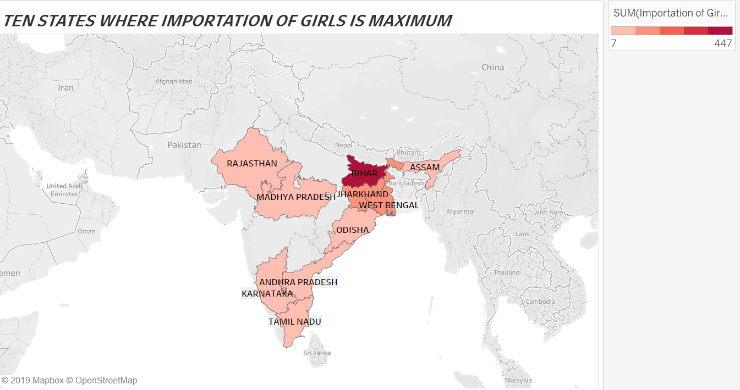
VISUALIZATION USING TABLEAU

Slide 10
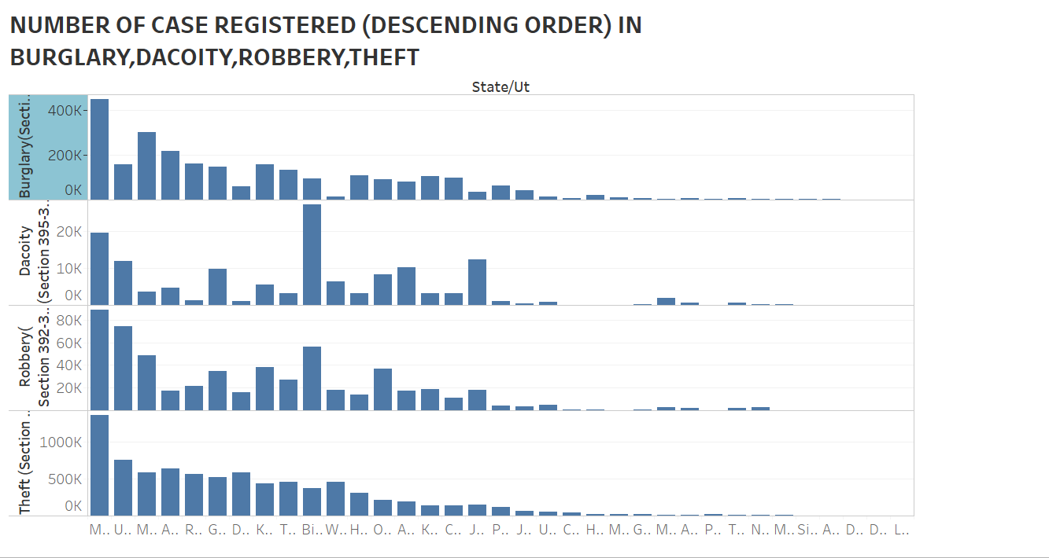

Slide 11
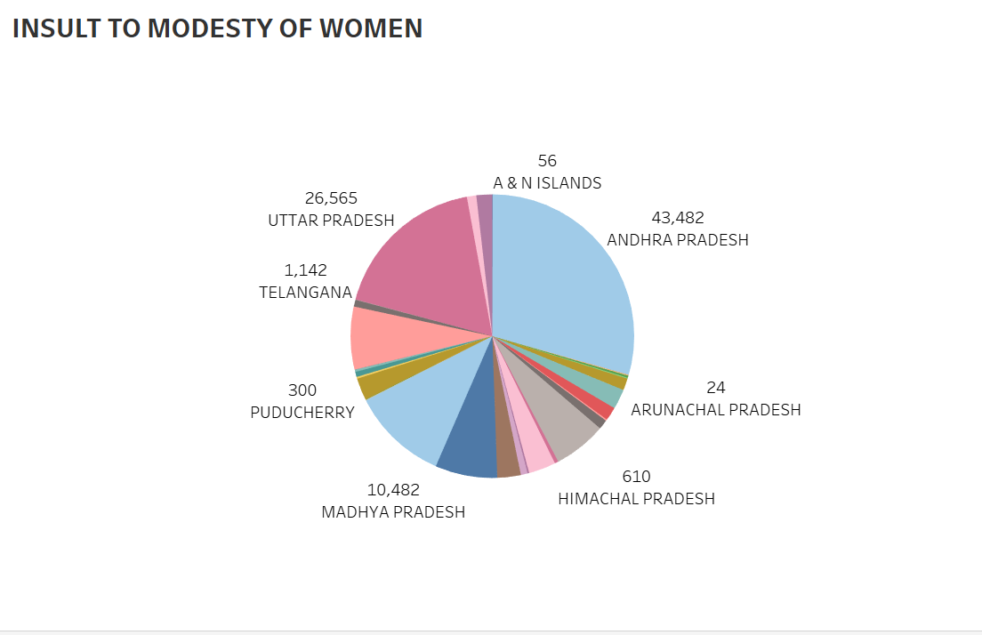

Slide 12
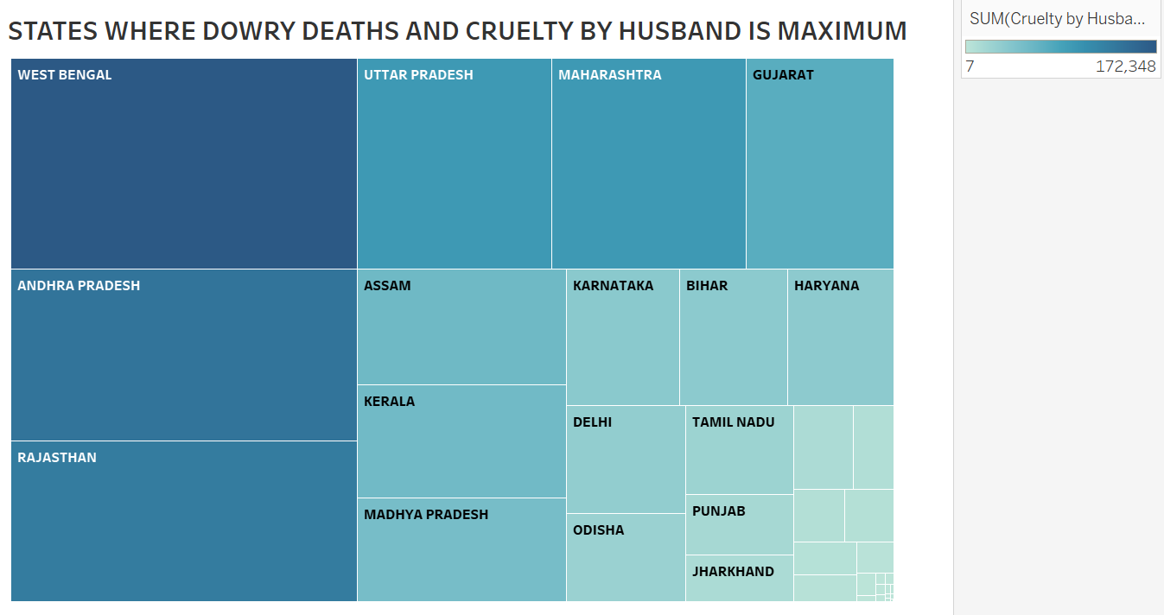

Slide 13
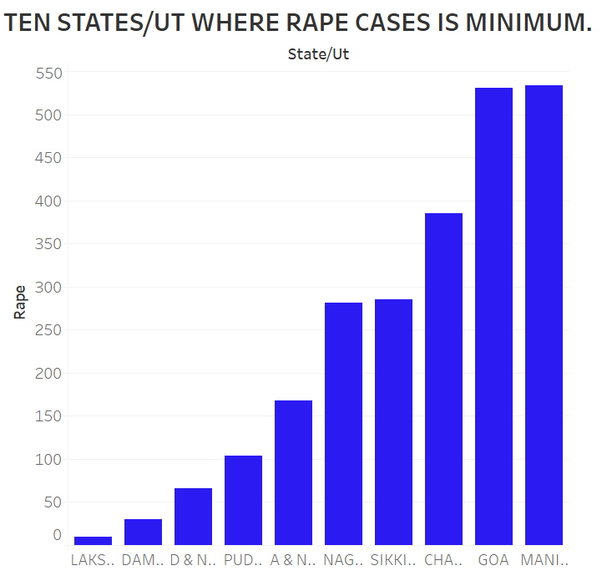

Slide 14
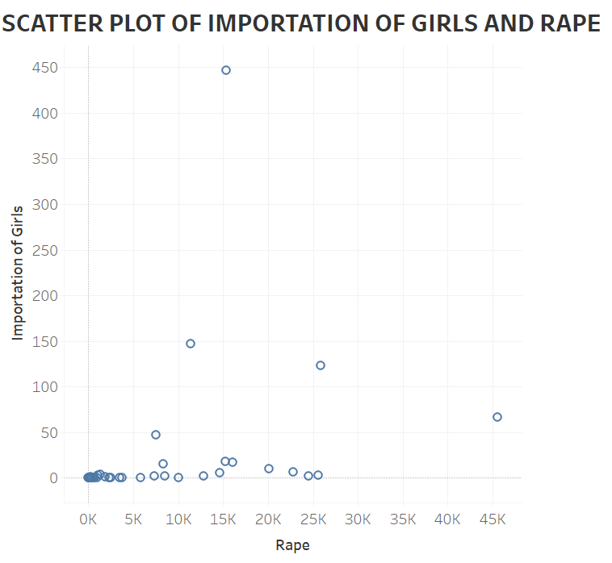

Slide 15
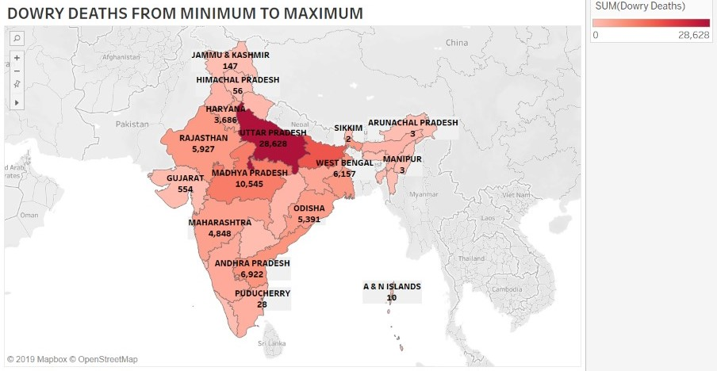

Slide 16
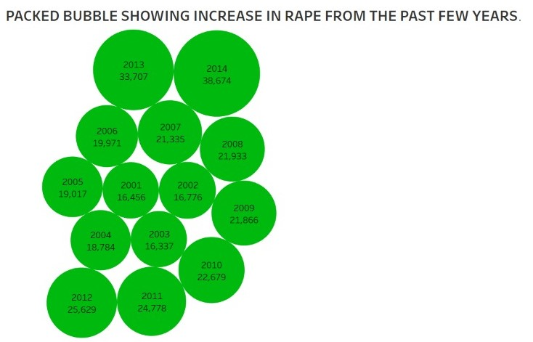

Slide 17
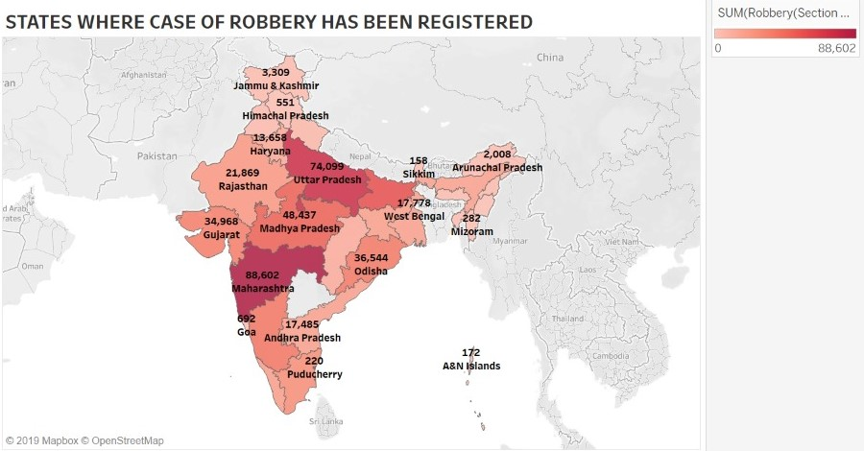

Slide 18
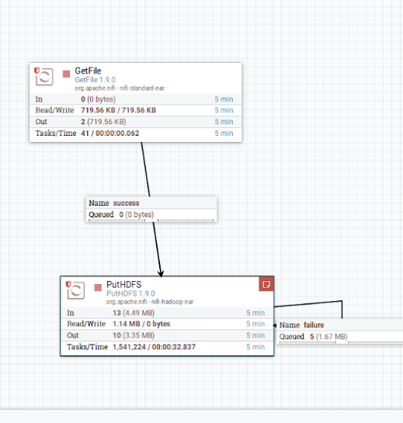
DATA TRANSFER FROM LOCAL SYSTEM TO HDFS USING NIFI

Slide 19
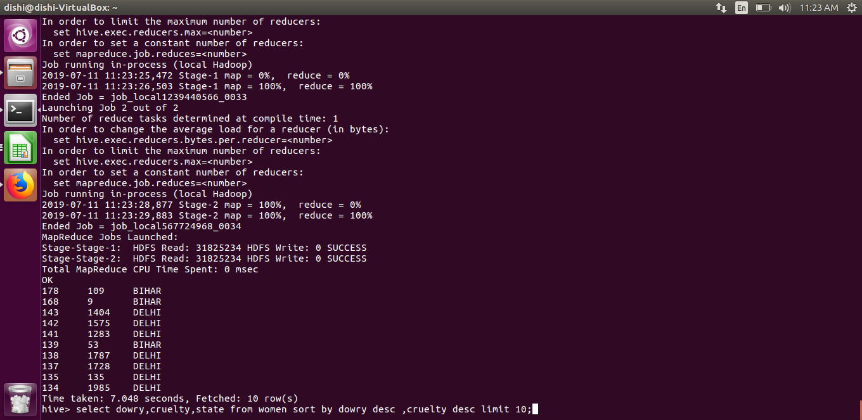
OBJECTIVES PERFORMED USING HIVE

Slide 20
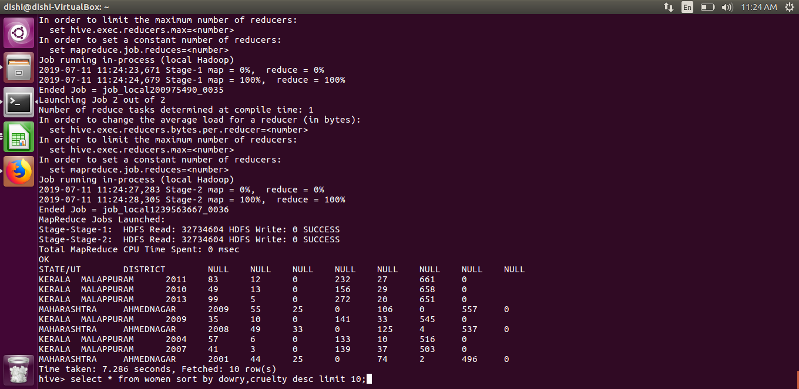

Slide 21
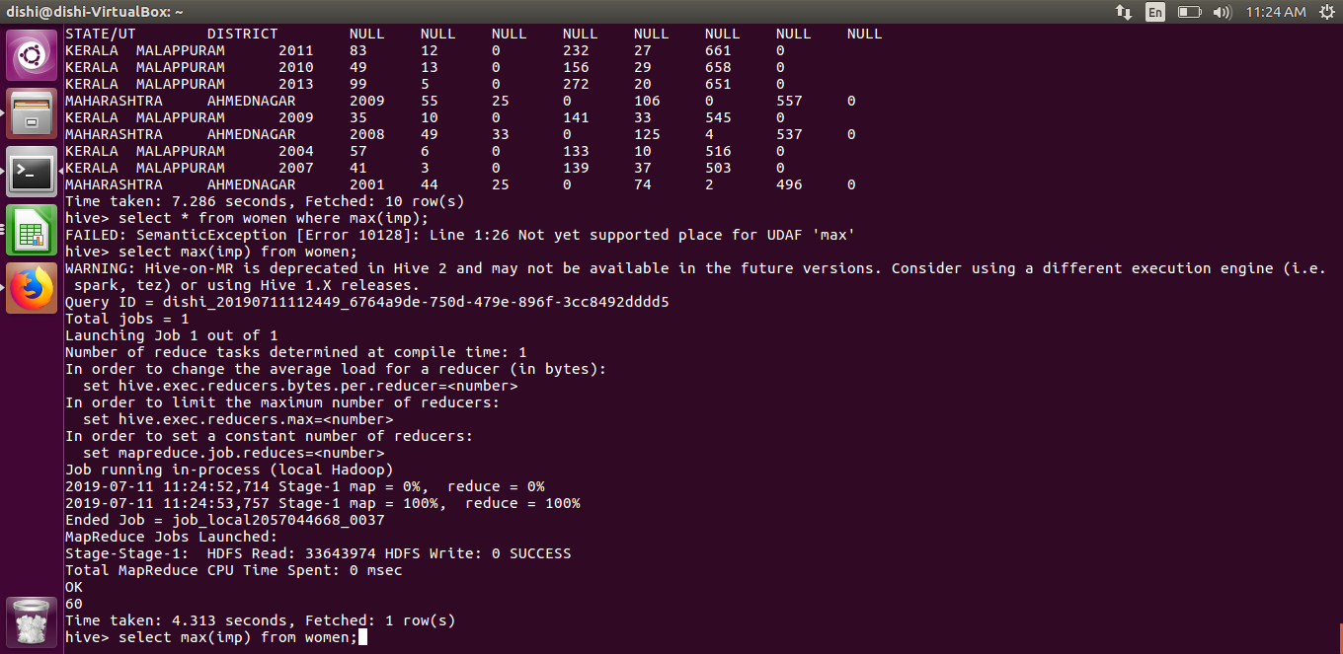

Slide 22
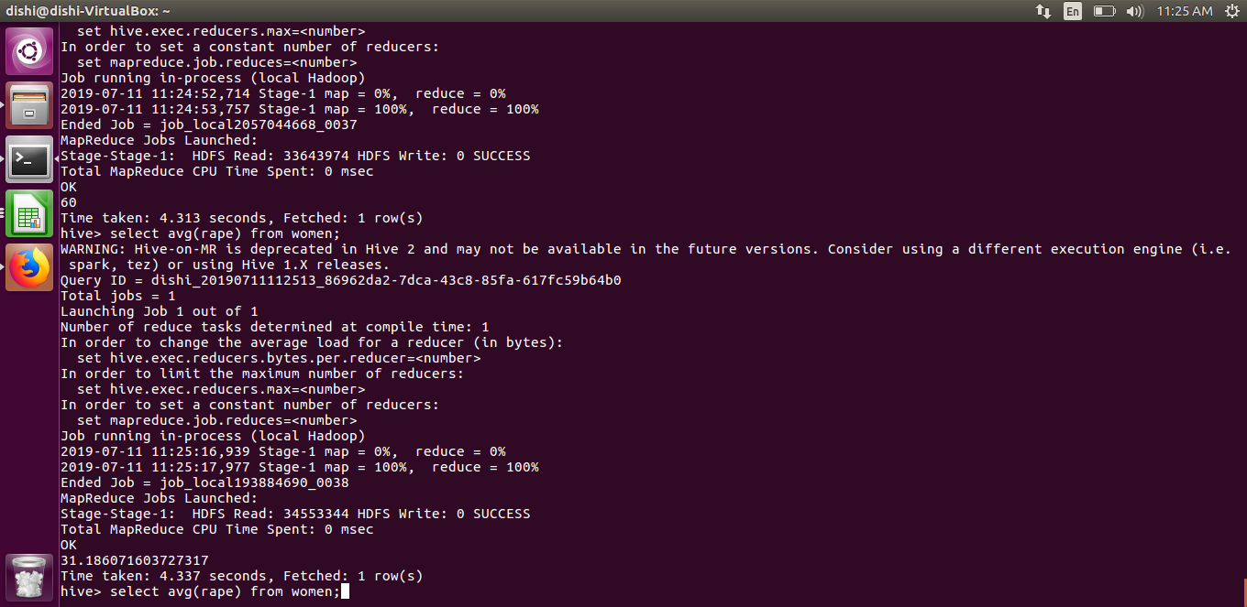

Slide 23
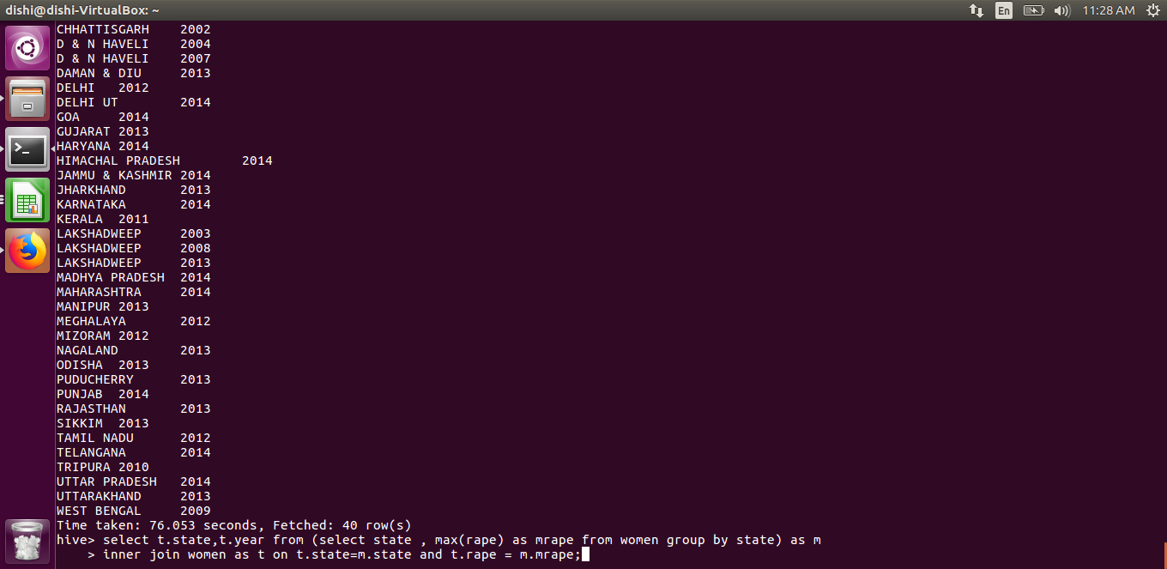

Slide 24
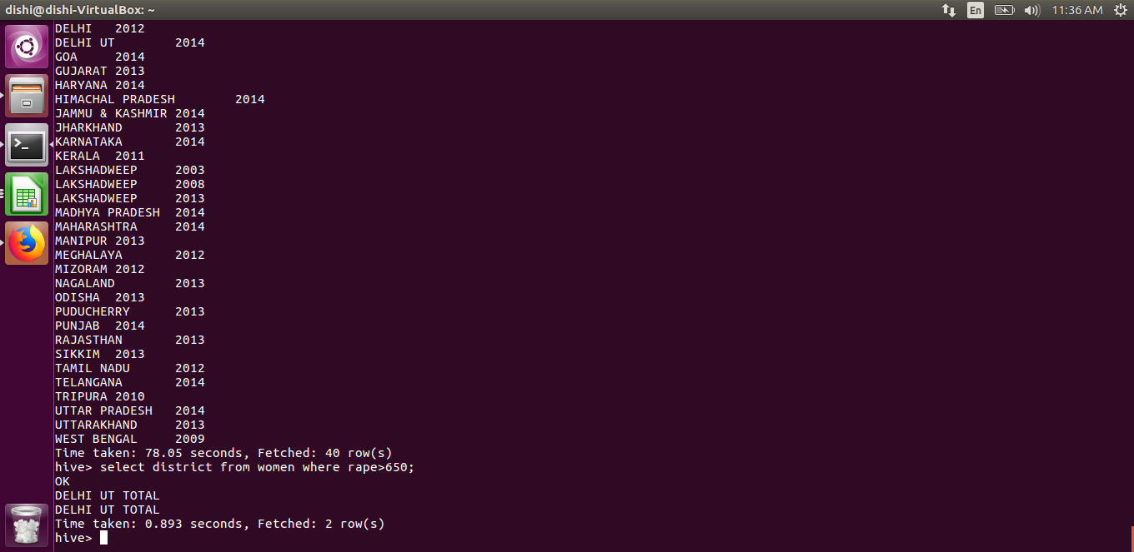

Slide 25
REFERENCES
https://www.researchgate.net/publication/301234244_Crime_Data_Analysis_Using_Pig_with_Hadoop
http://www.ijetmr.com/Articles/National-Conference-CINSP-2018/IJETMR18-CINSP-10.pdf
https://www.youtube.com/watch?v=jj6-0cvcNEA&t=9542s
https://www.youtube.com/watch?v=tKNGB5IZPFE&t=85s
https://www.youtube.com/watch?v=mafw2-CVYnA

